Slide 1
Green branding effects on consumer response: examining a brand stereotype-based mechanism
Siyu Gong, Guanghua Sheng, Peter Peverelli and Jialin Dai
Journal of Product & Brand Management Vol 30 Issue 7 (2021)
Notes:
15 minute presentation
20 slides (gross 45 secs/slide)
30-40 secs per slide content and 5 sec transition (45 secs)

Slide 2
Chapter 1 - Introduction
Motivation for brands behind Green Branding:
Meet regulations
Compete for Green Consumers
Gaps in existing literature:
Role of green brand positioning strategies in framing consumer perception that leads to certain attitudes and purchasing intentions
Effect of individual difference variables on different green brand positioning strategies
Emerging green markets like China and application of green branding strategies there
How different types of green attributes help consumers create brand associations
Gong et al wanted to find insights and create actionable guidance for brand practitioners to use in their green branding strategy to increase brand value and sales
But before moving on…
Notes:
Average slide: make 2 main points, with no more than 2 sentences for each point. Average sentence: 15 words.

Slide 3
Chapter 2 - Theoretical Background
Green Branding: communicating a brand’s unique environmentally friendly attributes to target customers
2 types of green branding strategies:
functional attribute positioning strategies: tangible benefits examples - energy savings, low carbon footprint and recyclability
emotional attribute positioning strategies: symbolic benefits examples - goodness, generosity and self-esteem
Construal Level Theory:
The more psychologically distant an object is from the individual (in time or space), the more abstract it will be thought of
The closer the object is, the more concretely it will be thought of
DC 2024 vs Australia 2030
Notes:
Average slide: make 2 main points, with no more than 2 sentences for each point. Average sentence: 15 words.

Slide 4
Chapter 2 - Theoretical Background
Brand stereotyping:
Competence perceptions: brand’s ability to complete specific actions. examples - confidence, intelligence and competitiveness traits
Warmth perceptions: behavioural intention of brand. examples - trustworthiness, friendless and sincerity traits
When a combination of emotional and functional benefits are communicated about a brand’s eco-friendliness, both planned behaviour and reasoned action is evoked in the customer’s mind, shaping the customer’s positive attitude and purchase intentions towards the brand (“golden quadrant”). – Aaker et al (2012)
 | Golden Quadrant
Perceived Competence
Perceived Warmth
Notes:
Average slide: make 2 main points, with no more than 2 sentences for each point. Average sentence: 15 words.

Slide 5
Chapter 1 - Introduction
Back to it…
This paper proposes:
Consumers link perceptions of green brands’ functional and emotional positioning to either “warm” or “competent” stereotypes
Based on their “construal level”, consumers may have preference for one type of green brand positioning strategy over the other.
Consumers who construe information at a higher level are more likely to focus on the abstract social value of green brands and will feel more warmth and competence perceptions towards green emotional positioning strategies
Consumers who construe information at a lower level are more likely to focus on the concrete utilitarian environmental benefit of green brands and will generate more warmth and competence perceptions towards green functional positioning strategies
Methodology:
The research is based on experimental design, which uses consumer samples and advertisement stimuli to expose participants to the two types of green positioning strategies under controlled conditions.
Notes:
Average slide: make 2 main points, with no more than 2 sentences for each point. Average sentence: 15 words.

Slide 6
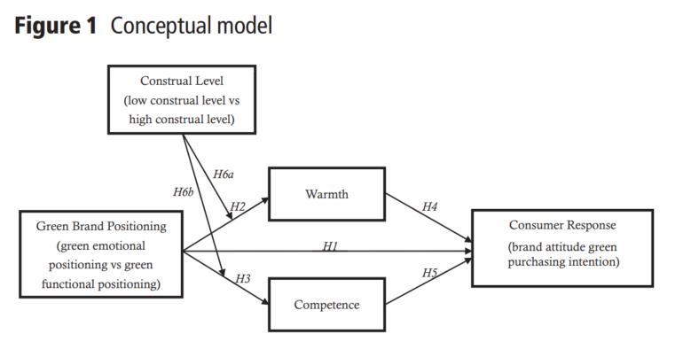
Notes:
Average slide: make 2 main points, with no more than 2 sentences for each point. Average sentence: 15 words.

Slide 7
Chapter 2 - Hypothesis Development
Hypotheses:
H1: Green emotional and functional positioning have a positive effect on consumer response. – Study 1
H2: Green emotional positioning strategies are judged higher on warmth.
H3: Green functional positioning strategies are judged higher on competence.
H4: Perceptions of warmth increases the efficacy of green brand positioning.
H5: Perceptions of competence increases the efficacy of green brand positioning.
H6. Emotional and functional branding works differently at different construal levels:
H6a. Emotional positioning works better when targeted at a high construal level.
H6b. Functional positioning works better when targeted at a low construal level.
– Study 2
– Study 3
Notes:
Average slide: make 2 main points, with no more than 2 sentences for each point. Average sentence: 15 words.

Slide 8
3. Study 1
Tests whether green emotional and green functional positioning strategies positively affect consumer’s brand attitude and purchasing intention.
Undergraduate students from a university in Northeast China were recruited to participate in the experiment.
Positioning of an established green dairy brand “Mengniu” was manipulated to result in three experimental conditions
Emotional
Functional
Control
Three versions of media endorsements similar in structure, word count and presentation format, but differing in whether they conveyed emotional benefits, functional attributes or none of them. (examples below)
Responses to questionnaire in the form of seven-point scale rating (1 = strongly disagree; 7 = strongly agree)
At a significance level of p < 0.01, the results are statistically significant
Results suggest that green brand positioning has a positive effect on consumer response.
Notes:
Average slide: make 2 main points, with no more than 2 sentences for each point. Average sentence: 15 words.

Slide 9
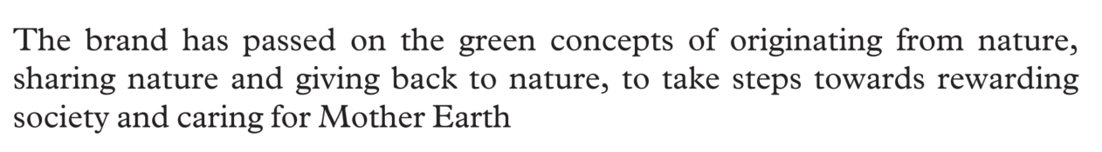
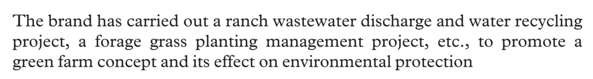

3. Study 1
Media endorsements:
1
2
3
Notes:
Average slide: make 2 main points, with no more than 2 sentences for each point. Average sentence: 15 words.

Slide 10

3. Study 1
Questionnaire:
This brand is close to nature
This brand is friendly
With this brand, I can feel good because I help to protect the environment
With this brand, I can express my environmental concern
This brand is leading
This brand is of high quality
This brand prevents global warming
Products of this brand do not pollute the environment
I think this brand is trustworthy
I think the function of the brand can fit my needs
I think the products of this brand is trustworthy
I will recommend this brand to my friends
I will consider buying products because they are less polluting
I would buy the products out of concern for the environment
The possibility of my purchasing the products of this brand is high
Emotional positioning
Functional positioning
Brand attitude
Purchasing intention
Notes:
Average slide: make 2 main points, with no more than 2 sentences for each point. Average sentence: 15 words.

Slide 11
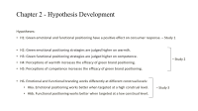
4. Study 2
Test if emotional and functional branding results in warmth and competence perception respectively
Test if emotional and functional branding results in positive attitude and buying intention respectively
Participants with different purchasing abilities from different regions of China were recruited to complete an online questionnaire
Positioning of a fictitious green air conditioner brand was portrayed in 2 experimental conditions:
Emotional – print advertisement featuring an image of a forest with the text “it feels like breathing fresh air in the forest”
Functional – print advertisement featuring a compelling image of an ordinary air conditioner and a description of how they release hydrofluorocarbons into the air, followed by the green brand’s claim of “no emission of hydrofluorocarbons through new ductless systems”
Response to questionnaire:
rating attitude and purchase interest on seven-point scales (1 = strongly disagree; 7 = strongly agree)
rating brand warmth and competence on three-item scales (warmth: kind, friendly and warm; competence: competent, intelligent and skilful)
Findings support H2-5 (at significance level of p < 0.001)
Notes:
Average slide: make 2 main points, with no more than 2 sentences for each point. Average sentence: 15 words.

Slide 12
5. Study 3
Test the effect of different consumer construal level on different green branding strategies
2 (green brand positioning) x 2 (construal level) between-subject experiment was conducted
MBA students from a university in Northeast China were recruited to participate in an online study
Construal level was manipulated by varying the temporal focus of the environmental value:
High: “the environmental value of the green brand benefits everyone in the future”
Low: “the environmental value of the green brand benefits everyone today”
One emotional and one functional brand positioning was displayed
Responses to 2 questions on seven-point scales (1 = not at all, 7 = very much):
How much emotional benefit do you seek from choosing this brand?
How much functional benefit do you seek from choosing this brand?
Findings: Matching emotional strategies to high-level and functional to low-level construal works best (p < 0.001)
Notes:
Average slide: make 2 main points, with no more than 2 sentences for each point. Average sentence: 15 words.

Slide 13
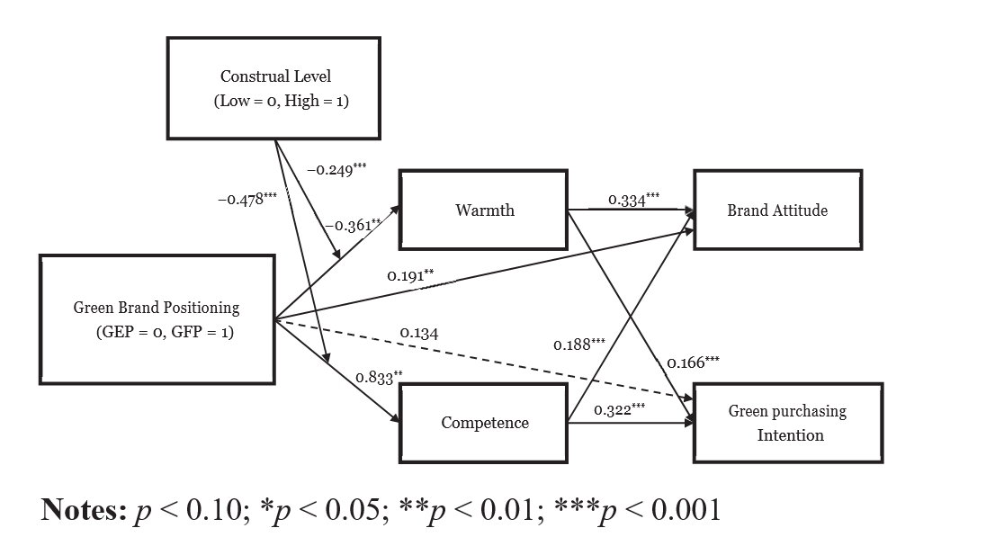
Notes:
Average slide: make 2 main points, with no more than 2 sentences for each point. Average sentence: 15 words.

Slide 14
General Discussion
Implications:
Academic:
Proves that emotional and functional positioning are equally important to generate positive attitudes and purchase intentions towards green brands
Shows that green emotional positioning strategies result in higher brand warmth perception and functional positioning result in higher competence perception.
Extends the body of knowledge regarding the effects of construal levels in green branding.
Managerial:
Provides guidance for brand practitioners for choosing the right green brand positioning strategy
Showcases the importance of combining emotional and functional benefits of green products to create comprehensive green brand positioning
Displayed examples of communicating messages of green brands at matching construal levels through subtle temporal cues.
Notes:
Average slide: make 2 main points, with no more than 2 sentences for each point. Average sentence: 15 words.

Slide 15
General Discussion
Limitations & Future Research Recommendations:
This study was conducted on green brands in the Chinese market. Future studies can control for the cultural effect to further establish generalizability of the underlying principles.
The study featured brands from the dairy and appliance industry. Future studies can replicate the research on other product categories to test generalizability.
This study focuses on the brand-stereotype mechanism to explain consumer response to green branding. Future research may investigate other variables that explain green consumer behavior.
This research used a quantitative analysis approach. Future research may attempt a qualitative case study approach to uncover further insights.
Notes:
Average slide: make 2 main points, with no more than 2 sentences for each point. Average sentence: 15 words.

Slide 16
General Discussion
My recommendation to improve the paper:
Role of public relations in communicating brand positioning.
Gong et al. while referring to brand positioning strategy, used only advertising as the mode of communication. Advertising is 1st party communication i.e. communication from the brand/seller itself. It is widely agreed upon that Public relations or 3rd party testimonial about the quality of a product/brand has a higher effectiveness in creating lasting brand recall and affinity. This is primarily due to the innate skepticism that customers have in believing the spokesperson of its own brand. However, people are more likely to believe the endorsement of an neutral/beloved personality (eg – influencer) about a brand.
Since PR is a lot more subtle than advertisements, the application of the methods outlined in this research need to be rethought and reworked to fit the medium. It will be an interesting new research direction to use PR to control the consumer perception of a green brand using the underlying principles of this paper.

Slide 17
DISCUSSION QUESTIONS

Slide 18
Discussion Questions
Question 1
Do you have a favorite green brand you are more drawn to than others?
Do you connect more with their emotional or functional positioning?
Do you internally consider the long-term or short-term positive implications on the environment while using their products?

Slide 19
Discussion Questions
Question 2
Consider Tesla – the green Electric Vehicle brand.
Which type of brand positioning does Tesla do better? emotional and functional.
How can they maximize consumer response for positive attitudes and buying intentions?

Slide 20
Discussion Questions
Question 2 example answer
 | Golden Quadrant
Perceived Competence
Perceived Warmth
Aaker, J.L., Garbinsky, E.N. and Vohs, K.D. (2012), “Cultivating admiration in brands: warmth, competence, and landing in the ‘golden quadrant’”, Journal of Consumer Psychology, Vol. 22 No. 2, pp. 191-194.

Slide 21
Discussion Questions
Question 3
Imagine you are a consultant working in marketing research. What other areas of green brand positioning would you like to investigate?
Were there any important considerations Gong et al. missed that caught your attention?
Could you have improved the methodology to make the findings more reliable?

Slide 22
Discussion Questions
Question 3 example answer
Important consideration missed: Role of public relations in communicating brand positioning.
Gong et al. while referring to brand positioning strategy, used only advertising as the mode of communication. Advertising is 1st party communication i.e. communication from the brand/seller itself. It is widely agreed upon that Public relations or 3rd party testimonial about the quality of a product/brand has a higher effectiveness in creating lasting brand recall and affinity. This is primarily due to the innate skepticism that customers have in believing the spokesperson of its own brand. However, people are more likely to believe the endorsement of an neutral/beloved personality (eg – influencer) about a brand.
Since PR is a lot more subtle than advertisements, the application of the methods outlined in this research need to be rethought and reworked to fit the medium. It will be an interesting new research direction to use PR to control the consumer perception of a green brand using the underlying principles of this paper.

Slide 23
Thank you

